Slide 1



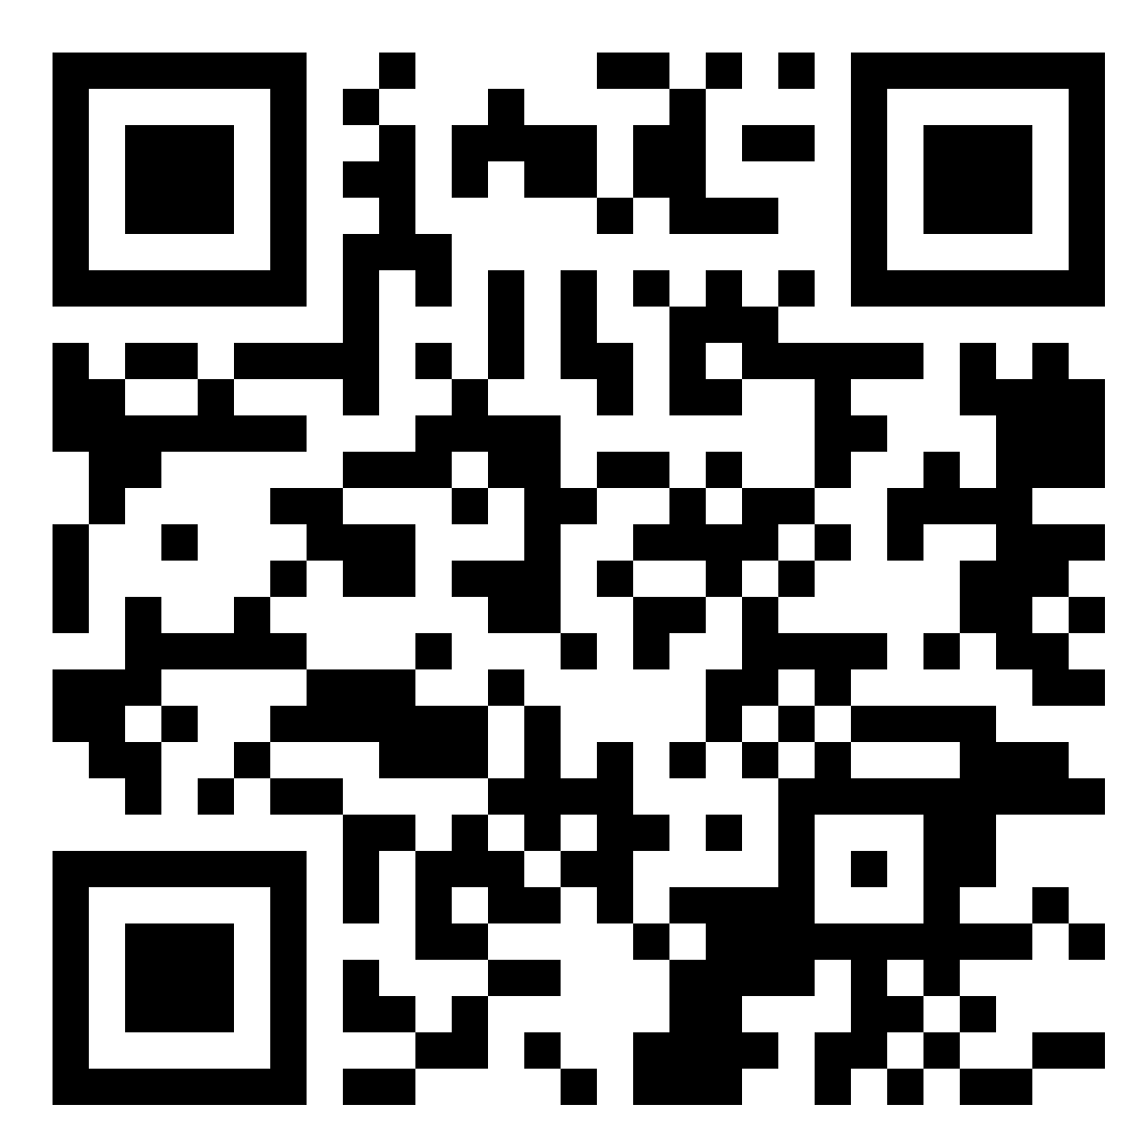

Welcome to
”Property Name”
Guest
Handbook & Manual
Scan QR code to get 15% off your next stay!
Book direct with
yourcompany.com

Slide 2

Flat Number, House No. Street Name, Area, Country, Postcode
Contact Details:
First Last Name (Host)
+441234567890
info@yourcompany.com
www.yourcompany.com
House Rules
Strictly No Parties Allowed
Parties are not permitted in the building or apartments at any time.
No Smoking Inside Building/Apartment
Smoking is prohibited inside the building or apartments. Please use designated smoking areas outside.
No Loud Noise or Music After 9 PM
To ensure a peaceful environment for all guests, please refrain from making loud noise or playing music after 9 PM.
Please note that any breach of these rules may result in immediate eviction, with the deposit being charged accordingly. Thank you for your cooperation in maintaining a pleasant environment for all guests at Stay Lux Serviced Apartments.
Scan QR code to get 15% off your next stay!
Notes:
2

Slide 3
When You Arrive
Check-in time:
Check-in time is 3pm. We can sometimes arrange an early check-in so please contact us if you will arrive early and we'll do our best, without any promises! We suggest you refer to the section on what to do if you arrive early - there is plenty to keep you entertained!
Check-out time:
Check-out time is strictly 11am. If you require a later check-out, we will do our best to accommodate your request, subject to availability. Please note that a £30 charge will apply for late check-outs, and we kindly ask that you inform us in advance. If we have guests arriving that day it will be almost impossible to offer a late check-out due to the cleaners needing to prepare for those guests.
Driving Directions:
If you are arriving via car and have a GPS / SatNav system in the car, please use “120 Grange Road B10 9QY”. You might also like to visit this link for Google driving directions:
https://maps.app.goo.gl/5AkV3REYekY6katm9
By Train:
Bordesley Station - 1 mile
Small Heath Station 0.9 miles
Duddeston Station - 2.2 miles
Scan QR code to get 15% off your next stay!
By Car:
Heartlands Hospital - 6 minutes
Birmingham City University - 10 minutes
St. Andrews Stadium (Football) - 5 minutes
Birmingham City Centre - 15 minutes

Slide 4
From Bordesley Station:
We understand that some of you will be traveling without a car. In this case finding us is pretty simple!
Once out of Bordesley Station:
Walk east on Coventry Rd/B4128 towards Upper Trinity St
Continue onto Bordesley Circus
Slight left onto Coventry Rd/B4128
Turn left onto Grange Rd
Destination will be on your right, at the end of Grange Rd.
Parking:
Free on-street parking outside apartment. Please DO NOT park in the parking spaces to the left of the property, it is privately owned by another company.
WIFI / Internet:
The house has free Wi-Fi. If you need to get to the router it’s located in the Living Room, on the windowsill.
ID: BT-N2FK2T
Password: CJGCUJQHF9kTqv
Rubbish / Recycling:
Bin Collection Day
The bins are collected Wednesday mornings.
Please put the bins at the front of the property if you are staying on a Tuesday night when staying in the property.
Black Outdoor bin
The Black Bin is only meant for household rubbish that cannot be recycled and for food waste.
The bin lid must be shut and your bin must not be too heavy or overloaded.
Blue Outdoor Bin
Plastic containers, including margarine and ice cream tubs, yoghurt pots, bottles and plastic food trays etc.
Aluminium foil, food trays or cans
Glass bottles or jars and lids
Aerosol cans and roll-ons
Scan QR code to get 15% off your next stay!

Slide 5
About The Apartment & Entertainment
Heating:
The heating is controlled by the electric heaters installed throughout the flat in every room. Please note, the flat is fully insulated to avoid the need for heating.
The Fridge/freezer:
You should not need to adjust any settings. If you run into any difficulties (e.g. it's not cooling efficiently) please let us know.
The Hob and Oven:
Using the Electric Hob:
Look for the power switch or button near the hob. It might be on the wall or the hob itself and turn on the power switch.
On the hob, you'll see some buttons or knobs. Find the one labeled "Power" or "On/Off."
Press or turn this button or knob to turn on the hob. You might hear a beep or see some lights come on.
After turning it on, you'll see some other buttons or knobs for controlling the heat. Turn the one you need to adjust the temperature.
Once it's heated, you're ready to start cooking!
When you're finished cooking, turn off the hob by using the power button or knob.
Wait for the hob to cool down completely before touching it or cleaning it. This might take a little while, so be patient.
Once it's cooled down, you can safely clean the hob with a soft cloth or sponge.
User manual: https://manuals.plus/cooke-lewis/clcer60a-electric-hob-manual#axzz8SJP2M8UQ
Scan QR code to get 15% off your next stay!
Notes:
5

Slide 6
Using the Oven:
Select the oven function that you wish to use by turning the knob that’s on the left of the oven.
Once you’ve selected your oven function choose the heat you would like to cook using the hob on the right of the oven.
Washing Machine:
Please follow the user manual here:
https://www.manuals.co.uk/bosch/waq24422ii/manual
Breakages:
We understand that sometimes accidents happen! Should you break anything please let us know immediately - if it's minor we usually won't charge. If it's a larger issue (e.g. the TV screen!) we would like to agree the cost with you before you leave to avoid any issues later. Thank you!
Television / Netflix:
The remote control for the living room TV should be on the coffee table. You’ll notice there is a on/off buttons at the top.
The red on/off button (top left) turns on the TV.
This TV has Netflix, Amazon Prime, Now TV, BBC iPlayer, ITV X and more. You should see specific buttons for these on the remote further down the middle.
Scan QR code to get 15% off your next stay!
Notes:
6

Slide 7
What’s Around
There’s lots to do in Birmingham. Check https://www.tripadvisor.co.uk/Attractions-g186402-Activities-Birmingham_West_Midlands_England.html for recommendations.
What’s Nearby:
Small Heath Park: 650 yd
Digby Park: 850 yd
Gateway Green: 950 yd
Kingston Hill Local Park: 0.8 mi
Adderley Park: 0.9 mi
Garrison Lane Park: 0.9 mi
Farm Park: 1 mi
Highgate Park: 1.3 mi
Avon Park: 1.3 mi
Ward End Park: 1.4 mi
Top Attractions:
Thinktank Birmingham Science Museum : 1.5 mi
Birmingham Back to Backs : 1.8 mi
Blakesley Hall Museum : 1.9 mi
Birmingham Museum & Art Gallery : 2.1 mi
Coffin Works : 2.3 mi
Brindleyplace : 2.5 mi
Museum of the Jewellery Quarter : 2.7 mi
National Motorcycle Museum : 3.2 mi
Winterbourne House and Garden : 3.2 mi
Lickey Hills Country Park : 9 mi
Scan QR code to get 15% off your next stay!

Slide 8
Restaurants Nearby:
Family Pizza: 200 yd
Ibrahims Grill Small Heath: 200 yd
Sam & Harrys: 200 yd
Airports Nearby:
Birmingham Airport: 3.9 mi
East Midlands Airport: 32 mi
Gloucestershire Airport: 42 mi
Scan QR code to get 15% off your next stay!

Slide 9
Check-out Instructions
Heating:
Before departing, please ensure that the heating system is turned off in all rooms to conserve energy and prevent any potential hazards.
Keys:
Upon check-out, please return all keys to the designated key safe provided. The correct key safe is situated on the top right-hand side of the front door. Ensure that the keys are securely placed inside the key safe and that it is properly locked. Thank you for your cooperation.
Key Safe Instructions:
Punch in the code provided using the keypad on the key safe.
Push down the button to open the key safe door.
Drop the keys inside and close the lid securely.
To lock the key safe, ensure the key safe number is set to the code before closing the lid completely. Failure to do so may result in the lid not closing properly.
After setting the key safe number to the code, enter a different code to lock the key safe completely.
Close the lid securely to ensure the key safe is locked.
Personal Belongings & Fees:
Before you leave, please make sure all your belongings are packed and that you've settled any outstanding fees, like late checkout charges or any additional services used during your stay. Our staff is here to help with any questions about your bill. Thank you for staying with “company name”!
Scan QR code to get 15% off your next stay!
Notes:
9

Slide 10
yourcompany.com
Notes:
10

